Slide 1
Action to Motion with VQ-VAE and
Transformer
Hongxuan Liu | Liwei Feng | Wendi Wu

Slide 2
Introduction
Related Work
Our Model
Evaluation
Challenges & Future Work

Slide 3
Introduction
Notes:
Here are some subtitles in our presentation.

Slide 4
Introduction
source:CRCV
The technique of action recognition has been widely used in our daily life, especially in security and filming areas.

Slide 5
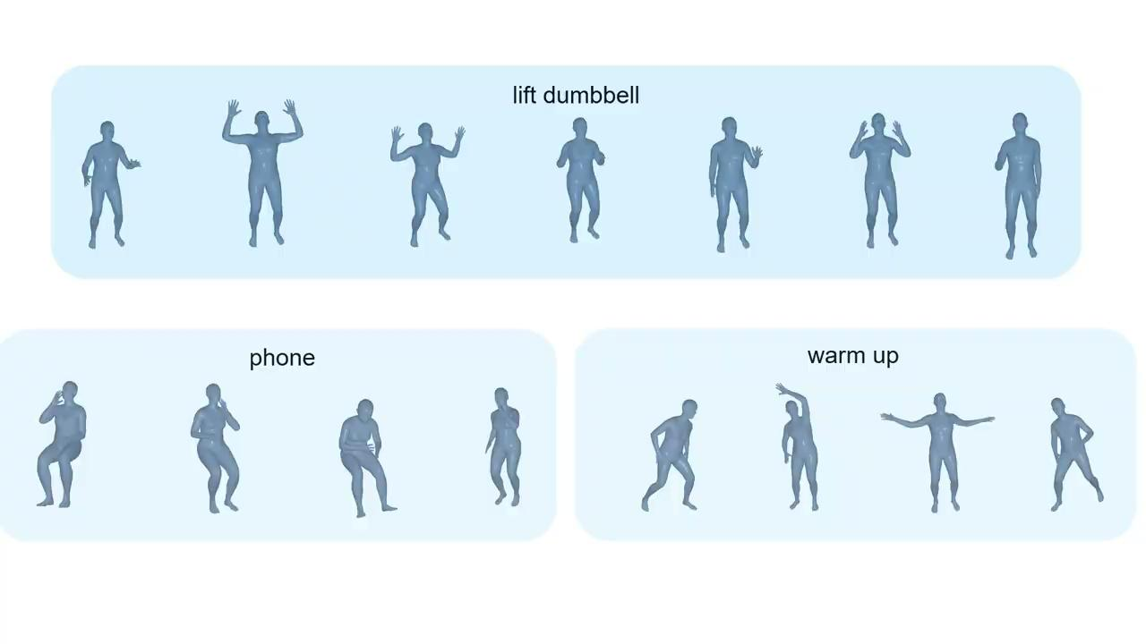
Introduction
At the same time, a reverse technique of action recognition is also developing rapidly.
https://www.youtube.com/watch?v=eDzN3mhNdeo&t=21s

Slide 6
Related Work
Notes:
Here are some subtitles in our presentation.

Slide 7
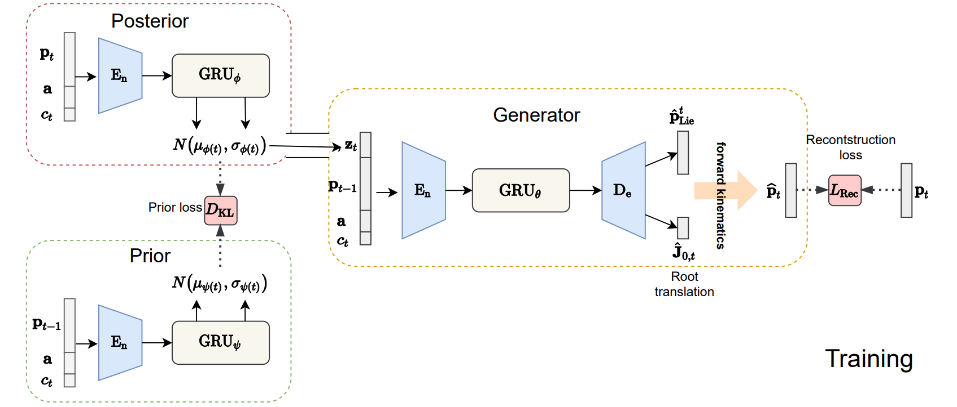
Related work~VAE
Given a real motion or pose sequence M = [p1, ..., pT ], VAE aims to maximize the probability of M sampled from the learned model distribution.
a: one hot vector representation of the action category input
Ct∊[0,1]: record where we are in the sequence generation progress, calculated as t/T, where T is the total length of the given motion
Pt-1: the ground truth of the pose in t-1
https://arxiv.org/pdf/2007.15240.pdf

Slide 8
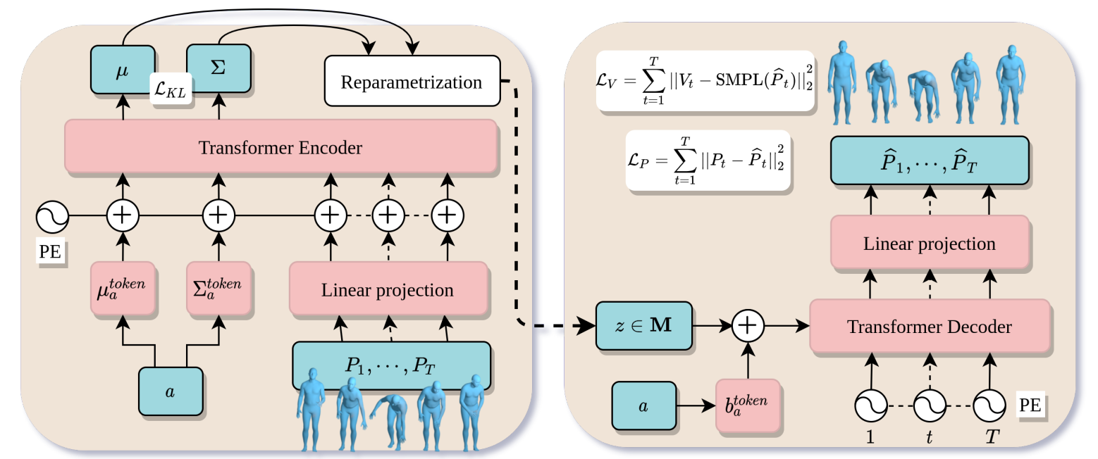
Related Work~Transformer + VAE
Encoder
Decoder
T:the duration of the motion, it also determines the number of PE (positional encoders) in decoder’s input
P1, . . . , PT: a sequence of body poses,
a: action label
µ, Σ: Distribution parameters on which we defined a KL loss
z: a motion latent representation sampled using µ and Σ
https://arxiv.org/pdf/2104.05670.pdf

Slide 9
Our model
Notes:
Here are some subtitles in our presentation.

Slide 10
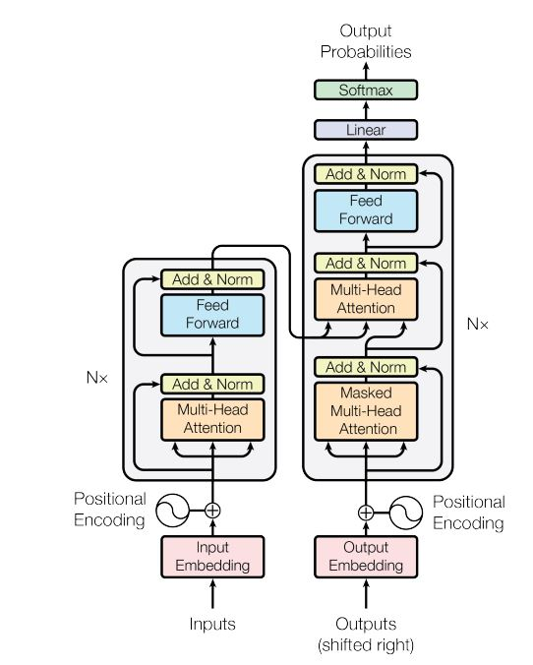
Our model ~ Transformer
Transformer
good for sequence data prediction
Encoder: mapping the input sequence of symbol representations to a sequence of continuous representations
Decoder: generating a predicted output sequence of symbols one element at a time
https://arxiv.org/abs/1706.03762v5
Notes:
Input -> encoder
Input -> encoder + decoder

Slide 11
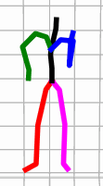
Our model ~ VQ-VAE
VQ-VAE
Translate continuous data to discrete number
This is what we want
https://arxiv.org/abs/1711.00937
Notes:
VQ-VAE is a type of variational autoencoder that uses vector quantization to obtain a discrete latent representation.
Encoder: mapping motion sequence onto a latent embedding space
Quantization: mapping sequence onto its nearest vector using learnable codebook
Decoder: decoding the quantization result and reconstructing the motion sequence

Slide 12
Our model ~ VQ-VAE + Transformer
Training Process
Input motion to the VQ-VAE encoder
Predict motion tokens from transformer

Slide 13
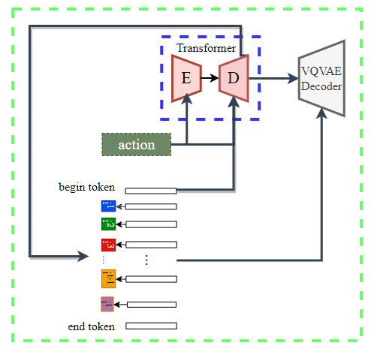
Our model ~ VQ-VAE + Transformer
Generation
Input action label and begin token to the transformer
Predicting the next token in the loop until reaching end token

Slide 14
Our model ~ Experiment
Experiment
Different representations of motions(absolute/relative coordinates)
Parameters of VQ-VAE(codebook size/conv layers)
Parameters of Transformer(encoder & decoder layers/head count)
Action label input

Slide 15
Evaluation
Notes:
Here are some subtitles in our presentation.

Slide 16
Evaluation ~ Dataset
Humanact12 a motion dataset that contains 12 different action categories with 34 sub categories and 1191 motion clips. It is widely used in action-to-motion experiments. In this dataset, these are 24 joints in each body pose. We are going to use 12 categories in our experiments
CMU MoCap a motion dataset that contains 2605 motion sequences with 22 body joints. And 8 actions are used in our experiments
NTU-RGB-D a motion dataset that contains 120 action categories and each pose has 18 body joints. A subset of 13 distinct actions are chosen in our experiments
https://arxiv.org/pdf/2007.15240.pdf
Notes:
now it is my turn to introduce evaluation part. We use three datasets in our experient. For Humanact12, it contains 12 different categories. And 24 joints in each body pose.
For Mocap, every motion has 22 boby joints and we use 8 actions in our experiment.
For NTU, 18 body joints for each pose, and 13 actions are used in our experiment.

Slide 17
Evaluation~Metrics
Frechet Inception Distance (FID): Distance between features of real images and features of generated images
Recognition Accuracy: Use a pre-trained classifier to predict the label of generated motions and calculate the accuracy
Diversity: Distance between some pairs of sampled motion features from various action type
Multimodality: Distance between some pairs of sampled motion features from same action type
Notes:
We have 4 evaluation matrics. FID is used to evaluate the overall quality of generated motions.
Recognition accuracy indicates the correlation of the motion and its action type.
Diversity measures the variance of the generated motions
Multimodality measures how much the generated motions diversity within each action type.

Slide 18
Evaluation ~ Humanact12 Result
Ground truth
Generated results
jump
walking
sit
Notes:
OK, now let look at our results. let us see jump action in Humanact, in the ground truth, he jumped happily, in genarated results, different one has a different jump, look at this gay, he seems to jump randomly. For walking, we could see someone walks to the left , someone to the right, and some one walk like a drinker.

Slide 19
Evaluation ~ MoCap Result
Ground truth
Evaluation results
run
step
dance
Notes:
For Mocap dataset, we could look at the dance action, you could find someone dance ballet, someone dance jazz and someone is freestyle.

Slide 20
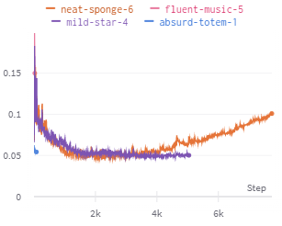
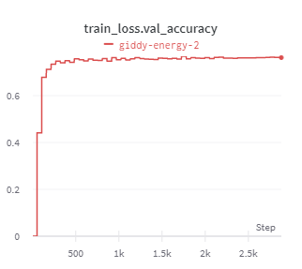
Evaluation ~ NTU Result
throw
salute
cheer up
Ground
truth
Generated results
Notes:
For NTU result, the loss for vqvae is about 0.05, and the accuracy for transformer is around 0.76. We have not gotten an ideal one, so only some simple motions like salute has a good generation, but the genarated result for throw and cheer up look a little strange. We are still working for this dataset and a machine is still training now, hoping we could get an ideal one these days.

Slide 21
Evaluation ~ Metrics Result
 | Dataset | FID | Recognition Accuracy | Diversity | Multimodality
Ground truth | Humanact12 | 0.0079 | 0.9782 | 7.0070 | 2.7412
 | MoCap | 0.0065 | 0.9152 | 6.2721 | 3.0007
VAE | Humanact12 | 2.458 | 0.923 | 7.032 | 2.87
 | MoCap | 2.885 | 0.68 | 6.5 | 4.12
Ours | Humanact12 | 1.5884 | 0.7727 | 6.8654 | 4.1061
 | MoCap | 4.7609 | 0.8295 | 6.595 | 3.4521
Notes:
For FID , the smaller the better and for others, the larger the better. The result for accuracy is weird. According the previous results, we should get a higher accuracy. We are still trying to tackle the issue.

Slide 22
Challenges
&
Future Work
Notes:
Here are some subtitles in our presentation.

Slide 23
Challenges
Resource limit
Tune hyperparameters such as codebook size/number of layers
Negative result for NTU dataset
Notes:
Now , let see challenge part, first, because resource limit, we have to spent money to rent GPU.
Second, we often use around one day for a training for one set of parameters, tune parameter waste us much time.
And the last one is the negative result for NTU dataset.

Slide 24
Future work
Try more different representation of motions, like SMPL, 6d, Lie Group
Find suitable hyperparameters for ntu_rgbd_vibe dataset
Build a model that generates motions involving two or more people
Notes:
For our future work, we will try more different representation of motions
Find suitable dataset for nut dataset
Troubleshooting the obtained accuracy
Build a model that …..

Slide 25
Thank you !

